Slide 1
MINI-PROJECT PRESENTATION ON
DEPARTMENTAL STORE MANAGEMENT SYSTEM

Slide 2
PRESENTATION OUTLINE
Abstract
Objective
Existing system
Proposed system
Advantages
Disadvantages
System requirements
Modules
conclusion

Slide 3
ABSTRACT
Based on the transactions in a Department store.
First activity is adding the items to the system along with their rates and names of the items which will be up for sale in the Department store. This authority is given only to Admin.
Any modification to be done in the item name or item rate can be done only by Admin.
Right to delete any item details rest with the Admin too.
As the customer buys the products and comes to the billing counter, the user is supposed to enter the item name purchased.

Slide 4
OBJECTIVE
To produce software which manage the activities done in a Department Store.
To reduce paper work; so that users can spend more time on monitoring the Department Store.
To reduce time in calculation of sales activities.
Add and maintain records of available products.
Add and maintain new entered category of products.
Provides a convenient solution of billing patterns.
Make an easy to use environment for users and customers.

Slide 5
EXISTING SYSTEM
Hinders smooth flow of work.
Lack of security of data.
Although more man power, but less efficiency.
Time consuming.
Consumes large volume of paper work.

Slide 6
PROPOSED SYSTEM
Reduced processing cost.
Automatic updating of product details.
Reduction of use of paper.
Reduction in man power.
Faster response time.
Easiness in modification of data.
User friendly.

Slide 7
SYSTEM REQUIREMENTS
HARDWARE REQUIREMENTS
  Processor Type : Pentium i3
  Speed : 3.40GHZ
  RAM : 4GB
  Hard disk : 500GB
  Keyboard : 101/102 Standard keys
  Mouse : Optical Mouse
  SOFTWARE REQUIREMENTS
  Operating System : Windows 10
  Front end : JDK 1.8/Net Beans 17
  Coding Language : Java

Slide 8
ADVANTAGES OF DEPARTMENT STORE
Economies of bulk buying
Variety in products
One Stop –All Needs
Economies in Advertising
Lesser Selling Prices

Slide 9
DISADVANTAGES OF DEPARTMENT STORE
Distance
High operational costs
Difficutly in Establishment

Slide 10
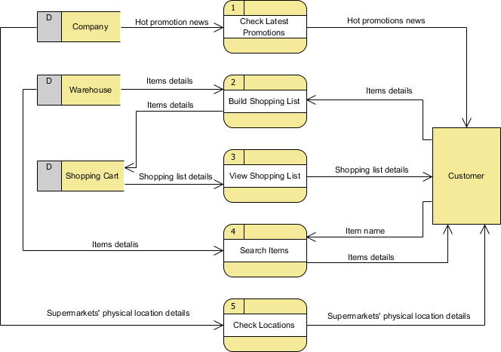
ARCHITECTURE OF DEPARTMENT STORE

Slide 11
MODULES DESCRIPTION
ITEM DETAILS
In this module we include all the item information and the details of the shops in the system . Each every products description with their information is stored here.
SALES
Every day details are all included in this system here we have all the information about every day sales and the products demand . As well as it include the details of ordering products.
PURCHASE
A purchasing department is the division of a company that’s responsible for acquiring the goods and services the business requires to operate.

Slide 12
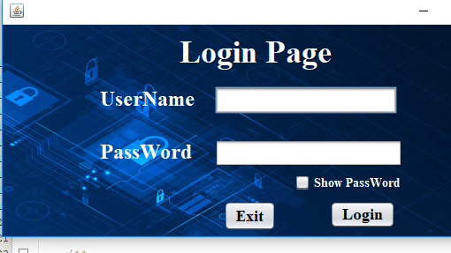
SCREENSHOTS :

Slide 13
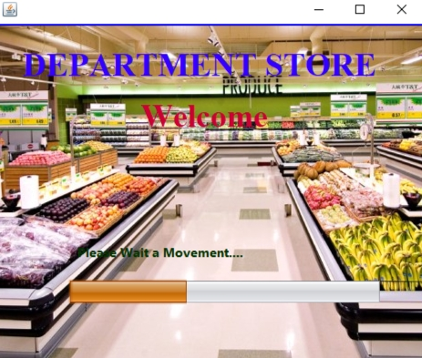

Slide 14
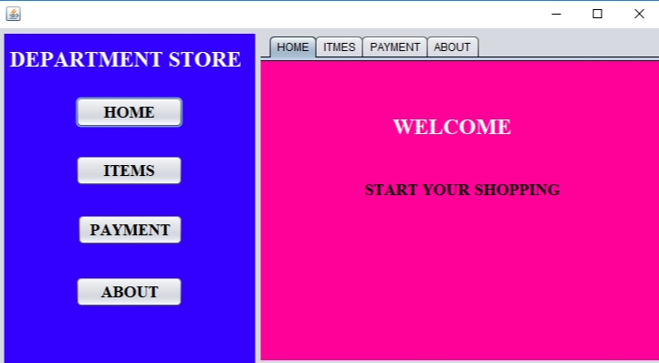

Slide 15
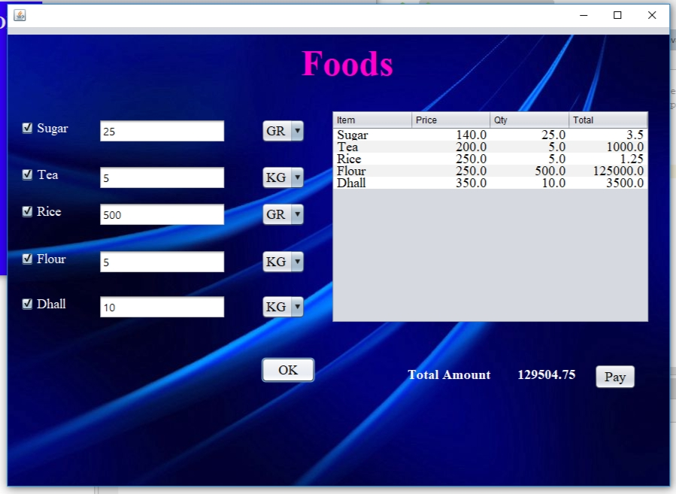

Slide 16
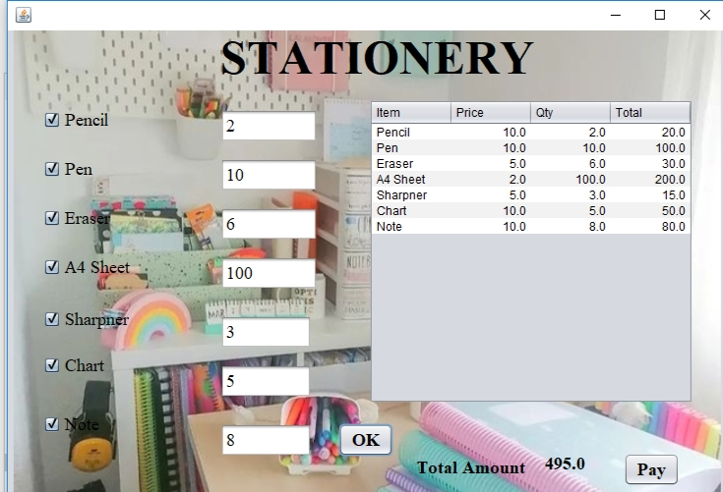

Slide 17
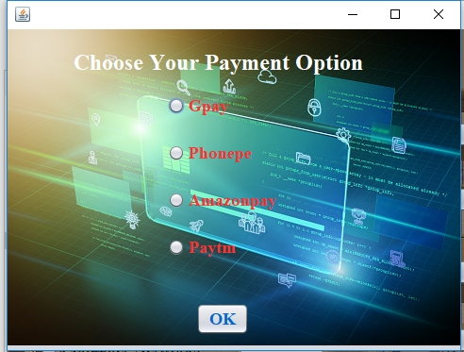

Slide 18
CONCLUSION
Online Grocery services meet a number of consumer needs including providing products for niche markets or helping the time starved consumer shop for the routine weekly groceries.
A department store must work towards satisfying its customers,because their income,revenue goodwill and rating depends upon them.

Slide 19
REFERENCES
Gunther Barth , ” The Department Store,” in City People:The Rise Of Modern City Culture in Nineteenth – Century America.
“Off Price Is The New Black For Retailers” Investor’s Business Daily.
McKeever,James Ross(1977).Shopping Center Development Handblook.

Slide 20
THANK YOU

